Slide 1
Review – MCP Neuron
Features of Neural Nets
Learning in Neural Nets
McCulloch/Pitts Neuron and Hebbian Learning
Review
One of the first neuron models to be implemented
Its output is 1 (fired) or 0
Each input is weighted with weights in the range -1 to + 1
It has a threshold value, T
x₁
The neuron fires if the following
inequality is true:
w₁
x₂
w₂
Σ
T
x₁w₁ + x₂w₂ + x₃w₃ > T
w₃
x₃

Slide 2
The Perceptron
Introduction to the Perceptron
Adaline Network
OUTLINE
b
The perceptron was suggest by Rosenblatt in 1958.
It uses an iterative learning procedure which can be proven to converge to the correct weights for linearly separable data
It has a bias and a threshold function
b
x₁
w₁
Σ
Θ
w₂
x₂
Activation function:
{
f(s) =
1 if s > Θ
0 if -Θ <= s <= Θ
-1 if s < -Θ

Slide 3
Perceptron Learning Rule
Weights are changed only when an error occurs
The weights are updated using the following:
w_{i}(new) = w_{i}(old) + αtx_{i}
t is either +1 or -1
α is the learning rate
If an error does not occur, the weights are
not changed

Slide 4
Limitations of the Perceptron
    The perceptron can only learn to distinguish between classifications if the classes are linearly separable.
    If the problem is not linearly separable then the behaviour of the algorithm is not guaranteed.
    If the problem is linearly separable, there may be a number of possible solutions.
    The algorithm as stated gives no indication of the quality of the solution found.

Slide 5
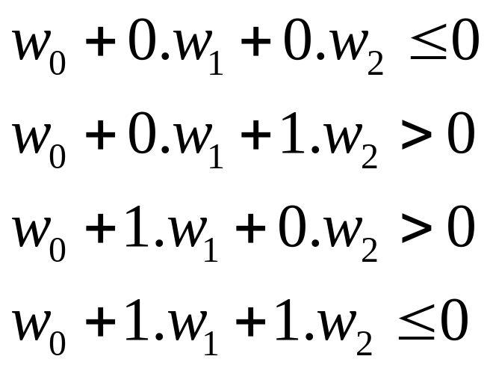
XOR Problem
A perceptron network can not implement an XOR function
o(x₁,x₂)
w₀
w₂
XOR(x₁,x₂)
w₁
INPUTS ARE DIFFERENT – 1 OUT
x₀ x₁ x₂
There is no assignment of values to w₀,w₁ and w₂ that
satisfies above inequalities. XOR cannot be represented!

Slide 6
MultiLayer Perceptrons
Perceptrons can be improved if placed in a multilayered network
Input
Layer
Hidden Layers
ϕ
ϕ
Output
Layer
x₁
1
ϕ
ϕ
ϕ
y₁
Inputs
x₂
1
Outputs
ϕ
ϕ
ϕ
y₂
x₃
1
w_{kl}
w_{ij}
ϕ
ϕ
w_{jk}

Slide 7
Adaline Network
Variation on the Perceptron Network
  inputs are +1 or -1
  outputs are +1 or -1
  uses a bias input
Differences
  trained using the Delta Rule which is also known as the least mean squares (LMS) or Widrow-Hoff rule
  the activation function, during training is the identity function
  after training the activation is a threshold function

Slide 8
Adaline Algorithm
Step 0: initialize the weights to small random values and select a learning rate, α
Step 1: for each input vector s, with target output, t set the inputs to s
Step 2: compute the neuron inputs
Step 3: use the delta rule to update the bias and weights
Step 4: stop if the largest weight change across all the training samples is less than a specified tolerance, otherwise cycle through the training set again
Neuron input
Delta rule
Σ
b(new) = b(old) + α(t - y_in)
w_{i}(new) = w_{i}(old) + α(t - y_in)x_{i}
y_in = b + x_{i}w_{i}

Slide 9
The Learning Rate, α
The performance of an ADALINE neuron depends heavily on the choice of the learning rate
  if it is too large the system will not converge
  if it is too small the convergence will take to long
Typically, α is selected by trial and error
  typical range: 0.01 < α < 10.0
  often start at 0.1
  sometimes it is suggested that:
  0.1 < nα < 1.0
  where n is the number of inputs

Slide 10
Running Adaline
One unique feature of ADALINE is that its activation function is different for training and running
When running ADALINE use the following:
  initialize the weights to those found during training
  compute the net input
  apply the activation function
Neuron input
Activation Function
{
1 if y_in >= 0
Σ
y_in = b + x_{i}w_{i}
y =
-1 if y_in < 0

Slide 11
Example – AND function
Construct an AND function for a ADALINE neuron
  let α = 0.1
1
b
x₁
w₁
Σ
0
x1 x2 bias Target
1 1 1 1
1 -1 1 -1
-1 1 1 -1
-1 -1 1 -1
w₂
x₂
Initial Conditions: Set the weights to small random values:
1
0.1
x₁
0.2
Σ
0
0.3
x₂

Slide 12
First Training Run
Apply the input (1,1) with output 1
The net input is:
y_in = 0.1 + 0.2*1 + 0.3*1 = 0.6
1
The new weights are:
The largest weight change
is 0.04
0.1
b = 0.1 + 0.1(1-0.6) = 0.14
w₁ = 0.2 + 0.1(1-0.6)1 = 0.24
w₂ = 0.3 + 0.1(1-0.6)1 = 0.34
1
0.2
Σ
0
1
0.3
1
Neuron input
Delta rule
Σ
b(new) = b(old) + α(t - y_in)
w_{i}(new) = w_{i}(old) + α(t - y_in)x_{i}
y_in = b + x_{i}w_{i}

Slide 13
Second Training Run
Apply the second training set (1 -1) with output -1
The net input is:
y_in = 0.14 + 0.24*1 + 0.34*(-1) = 0.04
The new weights are:
The largest weight change
is 0.1
1
b = 0.14 - 0.1(1+0.04) = 0.04
w₁ = 0.24 - 0.1(1+0.04)1 = 0.14
w₂ = 0.34 + 0.1(1+0.04)1 = 0.44
0.14
1
0.24
Σ
0
-1
0.34
-1

Slide 14
Third Training Run
Apply the third training set (-1 1) with output -1
The net input is:
y_in = 0.04 - 0.14*1 + 0.44*1 = 0.34
The new weights are:
1
The largest weight change
is 0.13
b = 0.04 - 0.1(1+0.34) = -0.09
w₁ = 0.14 + 0.1(1+0.34)1 = 0.27
w₂ = 0.44 - 0.1(1+0.34)1 = 0.31
0.04
-1
0.14
Σ
0
-1
0.44
1

Slide 15
Fourth Training Run
Apply the fourth training set (-1 -1) with output -1
The net input is:
y_in = -0.09 - 0.27*1 - 0.31*1 = -0.67
The new weights are:
The largest weight change
is 0.16
b = -0.09 - 0.1(1+0.67) = -0.27
w₁ = 0.27 + 0.1(1+0.67)1 = 0.43
w₂ = 0.31 + 0.1(1+0.67)1 = 0.47
1
-0.09
-1
0.27
Σ
0
-1
0.31
-1

Slide 16
Conclusion
Continue to cycle through the four training inputs until the largest change in the weights over a complete cycle is less than some small number (say 0.01)
In this case, the solution becomes: b = -0.5, w₁ = 0.5, w₂ = 0.5
Example – Recognize Digits

Slide 17
Multi-Layered Net (again)
output
neurons
hidden
layer
interconnects
input

Slide 18
Properties
Patterns of activation are presented at the inputs and the resulting activation of the outputs is computed.
The values of the weights determine the function computed. A network with one hidden layer is sufficient to represent every Boolean function. With real weights every real valued function can be approximated with a single hidden layer.

Slide 19
Training
Given Training Data,
  input vector set :
  { i _{n} | 1 < n < N }
  corresponding output (target) vector set:
  { t _{n} | 1 < n < N }
Find the weights of the interconnects using training data to minimize the error in the test data

Slide 20
Error
Input, target & response
  input vector set : { i _{n} | 1 < n < N }
  target vector set: { t _{n} | 1 < n < N }
  o_{n} = neural network output when the input is i _{n}
Error
Ε = __ Σ ( o_{n} - t_{n} )²
1
2

Slide 21
Error Minimization Techniques
The error is a function of the
  fixed training and test data
  neural network weights
Find weights that minimize error (Standard Optimization)
  conjugate gradient descent
  random search
  genetic algorithms
  steepest descent (error backpropagation)

Slide 22
Possible Quiz
What is a limitation of the perceptron?
What are the names of the layers in a multilayer net?
What is the role of training?
SUMMARY
Introduction to the Perceptron
Adaline Network

